Slide 1
Multimedia Computing
By
Minhaz Uddin Ahmed, PhD
Department of Computer Engineering
Inha University Tashkent.
Email: minhaz.ahmed@gmail.com

Slide 2
Content
Chapter - 3 (Gonzalez books)
Convolutions
Blurring
Sharpening
Edge detection
First order derivative
Compass gradient operators
Second order derivative operators
Color edge detection
Median filtering
Minimum/Maximum filtering

Slide 3
Image mask
A mask is a filter. Concept of masking is also known as spatial filtering. we just deal with the filtering operation that is performed directly on the image.

Slide 4
Filtering
The process of filtering is also known as convolving a mask with an image. As this process is same of convolution so filter masks are also known as convolution masks.
Types of filters
linear filters or smoothing filters
others are called as frequency domain filters.

Slide 5
Filtering
Filters are used for Blurring and noise reduction
Filters are used or edge detection and sharpness

Slide 6
Edges
Edges are significant local changes of intensity in a digital image. An edge can be defined as a set of connected pixels that forms a boundary between two disjoint regions. There are three types of edges:
Horizontal edges
Vertical edges
Diagonal edges

Slide 7
Edge detection
Edge Detection is a method of segmenting an image into regions of discontinuity. It is a widely used technique in digital image processing like
pattern recognition
image morphology
feature extraction

Slide 8
Edge detection
Edge detection allows users to observe the features of an image for a significant change in the gray level. This texture indicating the end of one region in the image and the beginning of another. It reduces the amount of data in an image and preserves the structural properties of an image.
Edge Detection Operators are of two types:
Gradient – based operator which computes first-order derivations in a digital image like, Sobel operator, Prewitt operator, Robert operator
Gaussian – based operator which computes second-order derivations in a digital image like, Canny edge detector, Laplacian of Gaussian

Slide 9


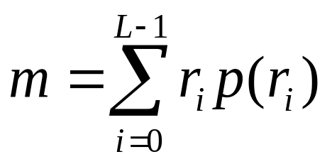
Histogram statistics for image enhancement
Use of histogram statistics for image enhancement
denotes a discrete random variable
denotes the normalized histogram component corresponding to the ith value of
Mean

Slide 10
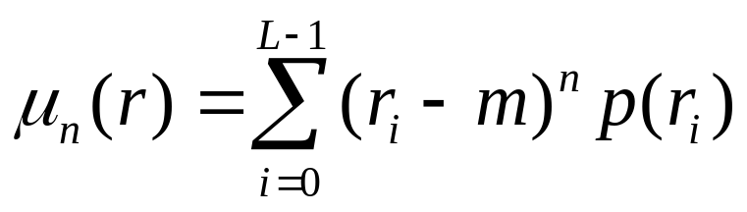
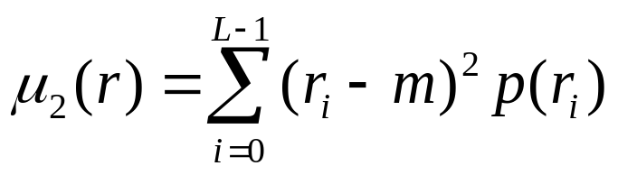
Histogram statistics for image enhancement
  The nth moment
  The second moment
  Global enhancement: The global mean and variance are measured over an entire image
  Local enhancement: The local mean and variance are used as the basis for making changes

Slide 11
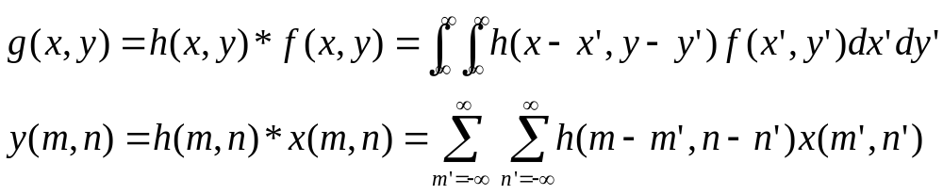
Convolution
Convolution (Mathematical formulation)
Discrete Convolution
  A convolution is merely a weighted sum of pixels in the neighborhood of the source pixel.
  The weights are determined by a small matrix called the convolution mask or convolution kernel.
  The new pixel value is computed by multiplying each pixel value in the neighborhood with the corresponding weight in the convolution mask and summing these products.
  The location of the center corresponds to the location of the output pixel
  Image smoothing, edge detection, and other effects.

Slide 12
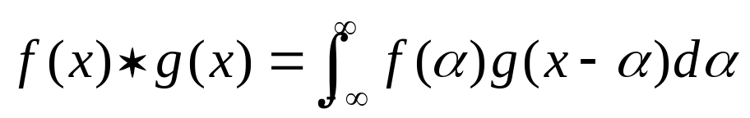
1D Convolution
1D Convolution
  Convolution is very important to understand image processing
  A basic operation of linear systems theory
  Convolution of two function f(x) and g(x)
  Intuitively, one function is swept past (1D) or rubbed over (2D) the other.

Slide 13
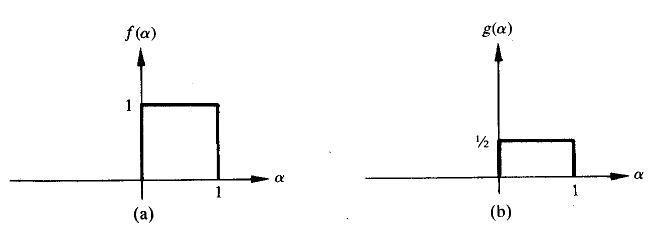
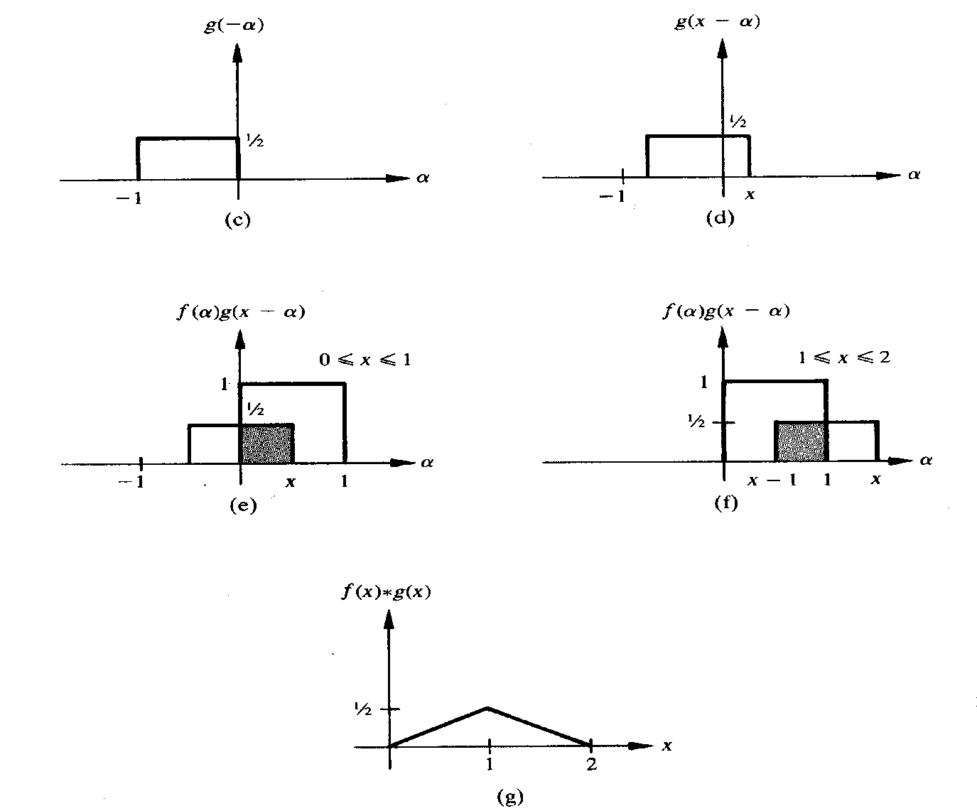
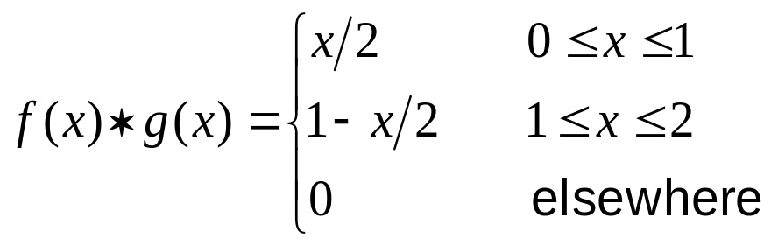

Slide 14
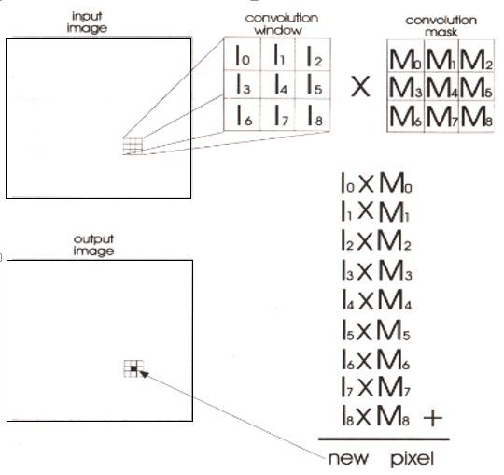
Convolution

Slide 15
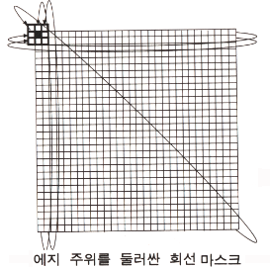
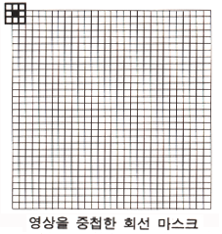
Convolution
How to treat image borders for convolution ?
  Zero-padding: treat the empty cells in the convolution window as zeros.
  Start convolving at the first position where window doesn’t overlap the image.
    Ex. Start comvolving at (1,1) instead of (0,0) with 3 x 3 convolution mask.
  Duplication of the edges
    Ex. Copy the top row, the left side, the right side, and the bottom of the image.
  Wrap-around
Duplication of the edges
Wrap-around

Slide 16


Blurring
Blurring
  Blurring (low-pass spatial filtering)
    Removes the finer details of an image.
    Can be accomplished through convolution.
  One common blurring mask
    all convolution coefficients are equal.
    In a 3 X 3 mask, all the elements equal 1/9,
    In a 5 X 5 mask, all elements equal 1/25.
    The bigger the mask, the greater the blurring effect.
  3 X 3 MASK 5 X 5 MASK

Slide 17
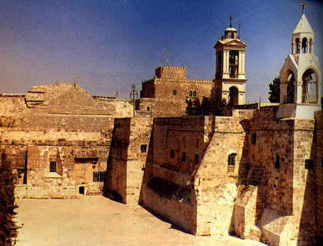

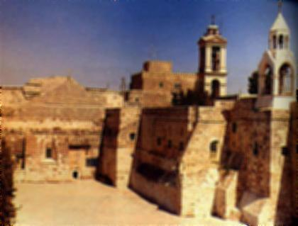

Blurring
Original Image
3X3 blurring
5X5 blurring
7X7 blurring
Notes:
https://setosa.io/ev/image-kernels/

Slide 18
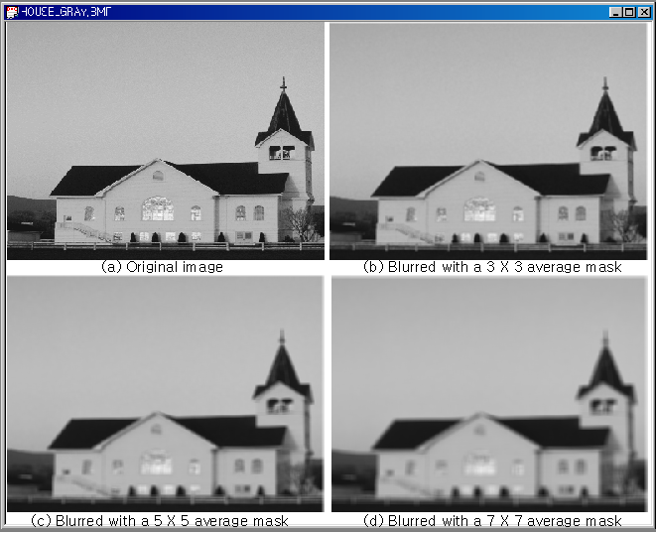
Blurring Example

Slide 19
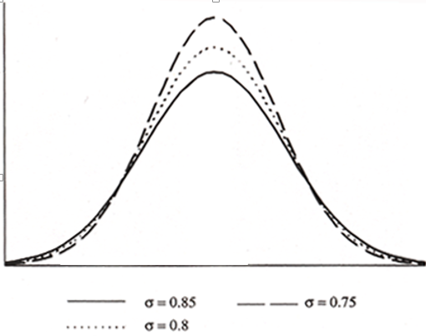

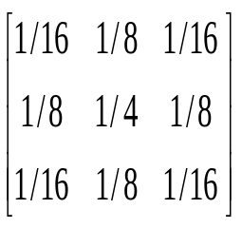


Gaussian Smoothing Filters for Burring
Gaussian smoothing filters & mask approximation
  controls the effective spread & size of the mask.
Original Image
Gaussian Filtering

Slide 20
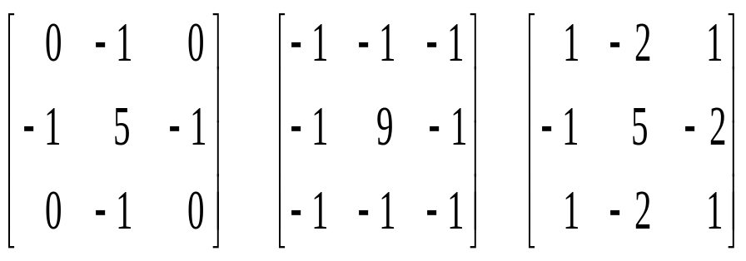
Sharpening
Sharpening
  Sharpening has the opposite affect of blurring.
  Sharpening, also referred to as crispening, emphasizes the details in an image.
  Sharpening an image will increase its contrast.
  Some sharpening mask:

Slide 21
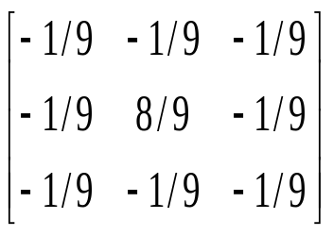
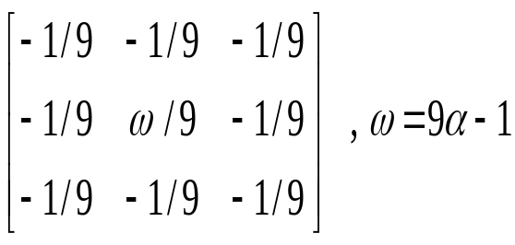
Sharpening(Cont’d)
High pass Filter
  Sharpening an image with the high filter.
    A high pass filter will remove the low frequency components and show only high detail.
    A common high pass filter mask:
Unsharp masking : another method of highpass filtering
  Subtract a lowpass filtered image from its original.
High-boost filtering:
  High - Boost = αOriginal - Lowpass
  When α = 1, the result is highpass filter.
  When α > 1, the effect is to restore low frequency
  Component.

Slide 22
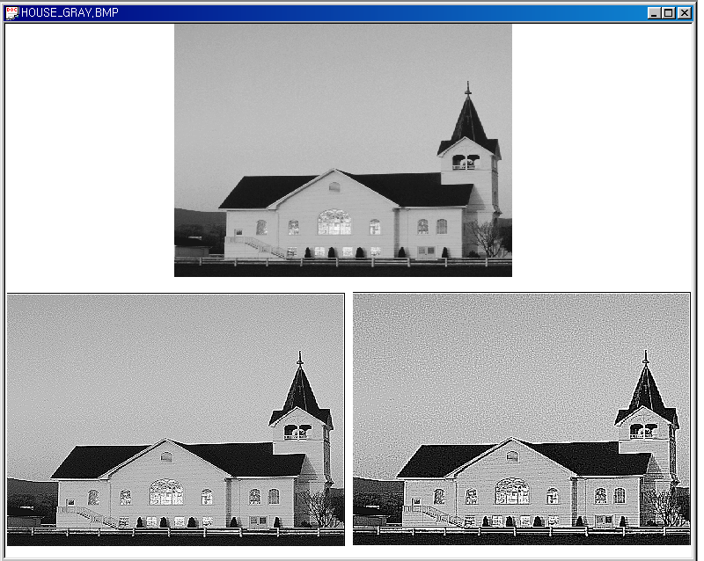
Sharpening Example
(a) Original image
(b) Sharpened image of 3 X 3 mask
(c) Sharpened image of 3 X 3 mask

Slide 23
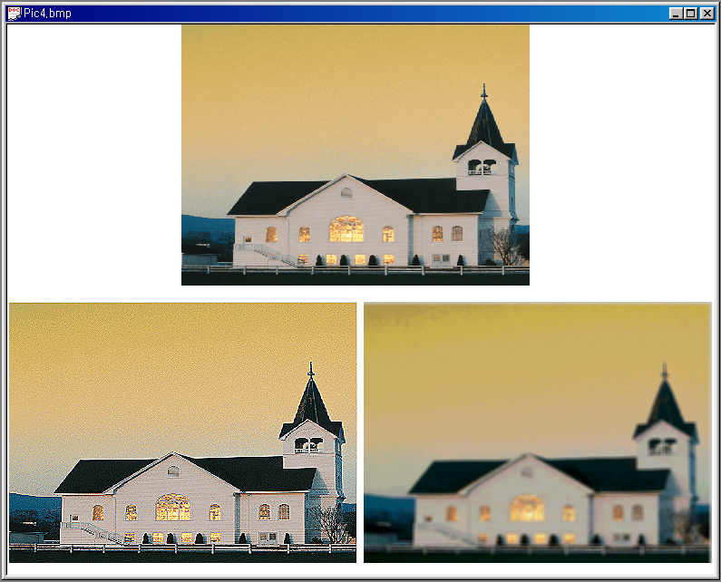
Color Sharpening & Blurring Example
(a) Original image
(b) Sharpened image
(c) Blurred image

Slide 24
High-boost filtering
  High-boost filtering(high-frequency emphasis filter):
  High - Boost = αOriginal - Lowpass
  When α = 1, the result is high pass filter.
  When α > 1, the effect is to restore low
  frequency component
  The effect of high-boost filtering:
    Retains more of original image’s background
    As α increases, the overall image gets lighter.
    Looks more like the original image, with a relative degree of edge enhancement.

Slide 25
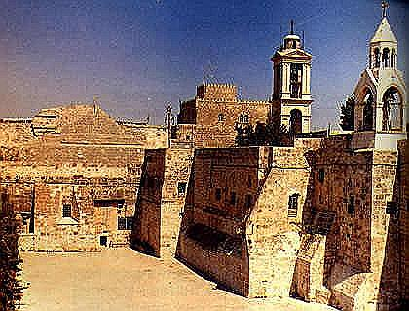
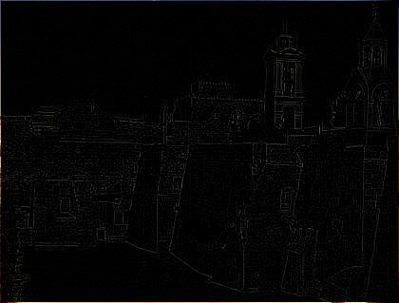
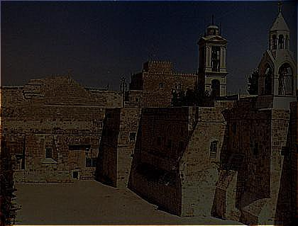
Sharpening
Original Image
Sharpening
Highpass
 =1.2 High-boost

Slide 26
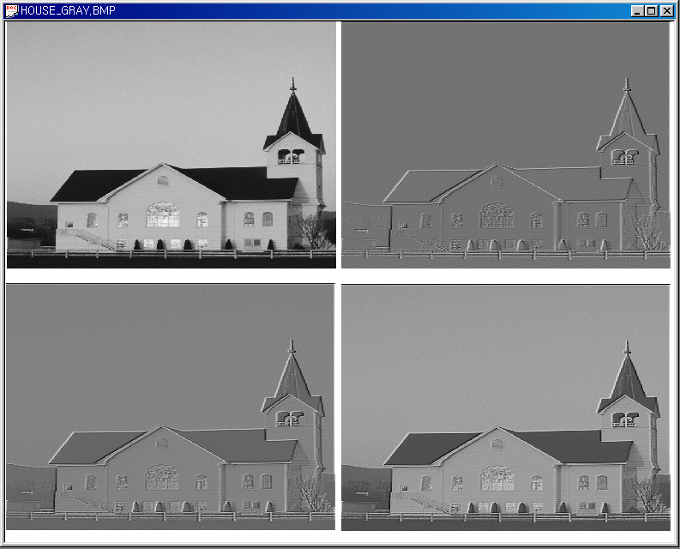
High pass filter & High-boost filter Example
(a) Original image
(b) High-pass filtered
(c) High-boost filtered =1.2
(d) High-boost filtered =1.7

Slide 27

Detection of discontinuities
Three types of discontinuities: points, lines, edges
Point detection:
  A point has been detected at the location at which the mask is centered if |R| >T
    Where T is a nonnegative threshold
    R =
Z₁ | Z₂ | Z₃
Z₄ | Z₅ | Z₆
Z₇ | Z₈ | Z₉
M₁ | M₂ | M₃
M₄ | M₅ | M₆
M₇ | M₈ | M₉

Slide 28
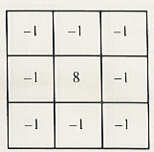
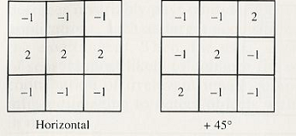
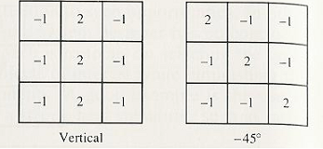
Detection of discontinuities
A mask used for detecting isolated points different from a constant background
Line masks for line detection

Slide 29
Edge Detection
  Isolated points and thin lines are not frequent occurrences in most practical applications.
  The most common approach for detecting meaningful discontinuities in gray level.
  Edge: the boundary between two regions with relatively distinct gray-level properties.
    Assume that the regions in question are sufficiently homogeneous s. t. the transition between two regions are determined on the basis of gray-level discontinuities alone.
  The idea underlying most edge-detection techniques
    The computation of a local derivative.

Slide 30
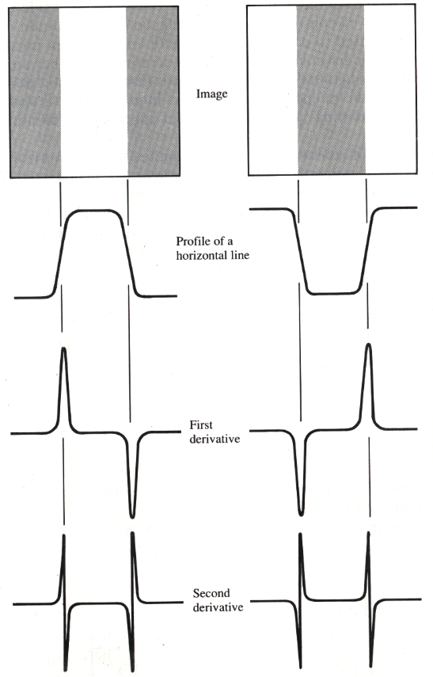
Edge Detection

Slide 31
Edge Detection
Edge Detection
  The edges of an image: hold much of the information in that image.
    The edges tell where objects are, their shape and size, and something about their texture.
    An edge is where the intensity of an image move from a low value to a high value or vice versa.
  roof edge line edge step edge ramp edge
    Infinite number of edge orientations, widths and shapes.
  The edge detection can be used in many applications.
    Image segmentation : Image segmentation: a field of image analysis, is used to group pixels into regions to determine an image's composition
    Image registration : aligns two images that may have been acquired at separate times or from different sensors.

Slide 32
Edge Detection
The edges of an image hold much of the information in that image
The edges tell
where objects are
their shape and size
something about their texture

Slide 33
Edge Detection
Edge detection techniques
  Homogeneity operator
    The simplest and quickest edge detectors determine the maximum value from a series of pixel subtractions.
    Subtracts each 8 surrounding pixels from the center pixel of a 3 X 3 window.
    The output is the maximum of the absolute value of each difference.
  Difference operator
    Similar to the homogeneity operator is the difference edge detector.
    It operates more quickly because it requires four subtractions per pixel as opposed to the eight needed by the homogeneity operator.

Slide 34
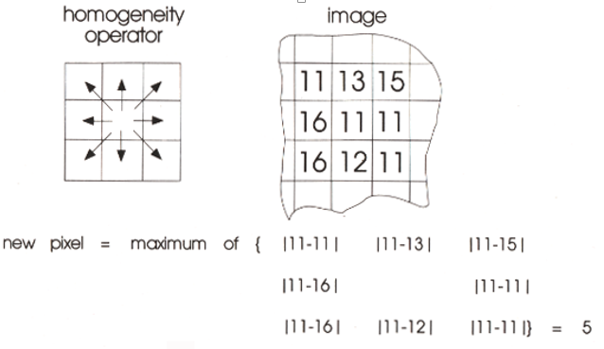
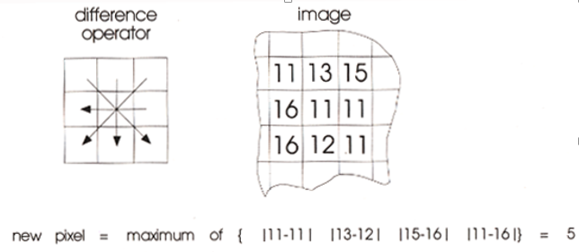
Edge Detection

Slide 35
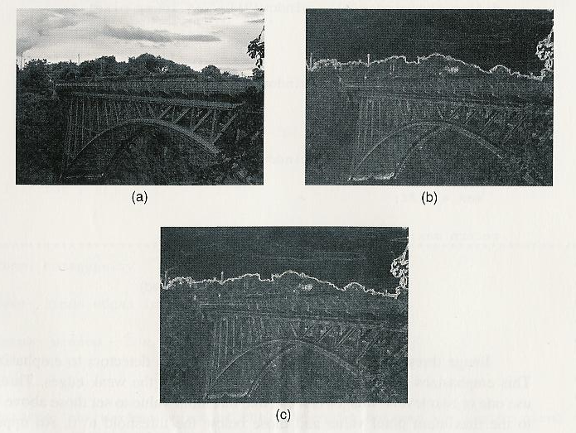
Edge Detection
.
Fig. 3.14 (a) Original image, (b) edge map of homogeneity operator, and © difference operator.

Slide 36
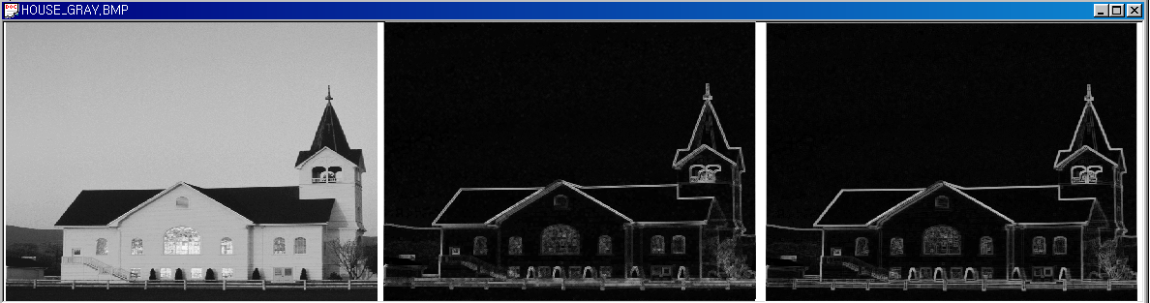
Edge Detection
(a) Original image
(b) Edge map of homogeneity operator
(c) Difference operator

Slide 37
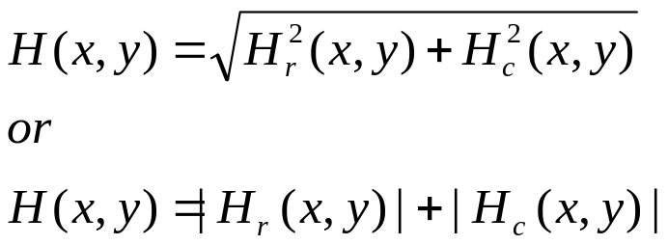
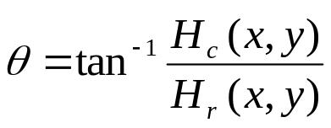


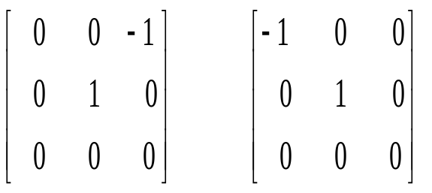
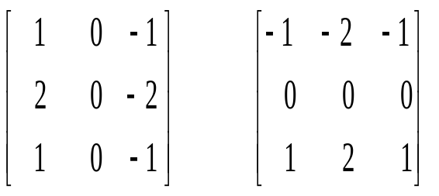
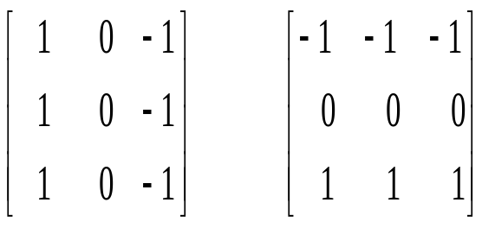
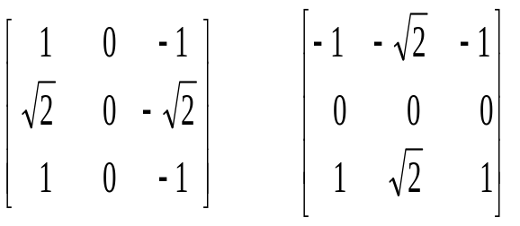
Derivative Operator
First Derivative Operator
Roberts
Operator
Sobel
Operator
Prewitt
Operator
Frei-Chen
Operator

Slide 38
Derivative Operator
Roberts operator
  Smaller effective area than the other masks
  More susceptible to noise
Sobel operator
  More sensitive to diagonal edges than vertical and horizontal edges.
Prewitt operator
  More sensitive to vertical and horizontal edges than diagonal edges

Slide 39
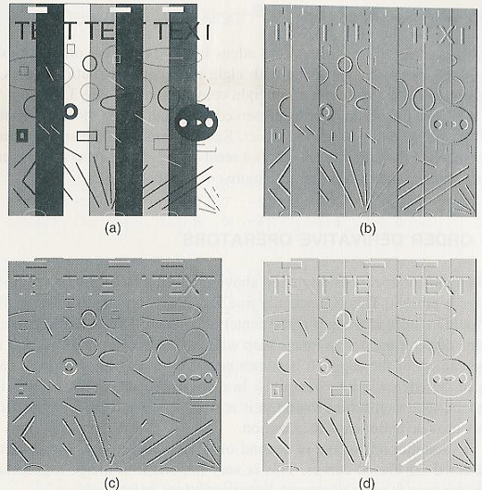
Derivative Operator
Fig. 3.17 (a) Original image, (b) Hr convolved, (c) Hc convolved, and (d) composite.

Slide 40
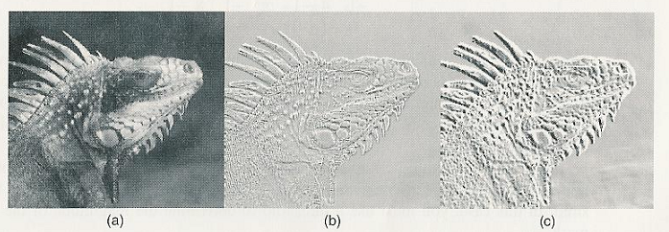
Derivative Operator
Fig. 3.18 (a) Original image, (b) processed with the Roberts operator, and 9c) processed with the Prewitt operator.

Slide 41
Compass Gradient Operator
Compass Gradient Operator
  Find edges in eight different orientations.
  Convolve an image with eight different masks.
  Prewitt, Kirsh, Robinson 3-level, Robinson 5-level
The effects of convolution
  Smaller masks are sensitive to noise
  Larger masks cannot resolve fine detail, and also
    Requires more computations.

Slide 42
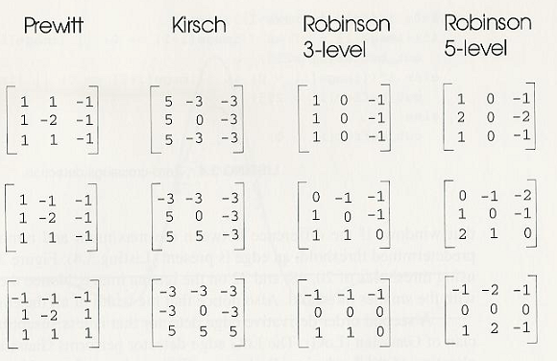
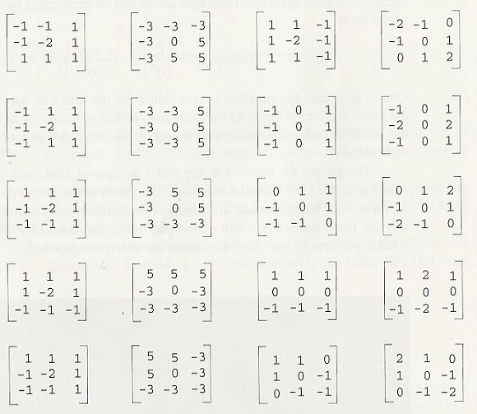
Compass Gradient Operator

Slide 43

Sobel Operator
Sobel Operator: It is a discrete differentiation operator. It computes the gradient approximation of image intensity function for image edge detection. At the pixels of an image, the Sobel operator produces either the normal to a vector or the corresponding gradient vector. It uses two 3 x 3 kernels or masks which are convolved with the input image to calculate the vertical and horizontal derivative approximations respectively

Slide 44
Sobel operator
Advantages:
Simple and time efficient computation
Very easy at searching for smooth edges
Limitations:
Diagonal direction points are not preserved always
Highly sensitive to noise
Not very accurate in edge detection
Detect with thick and rough edges does not give appropriate results

Slide 45
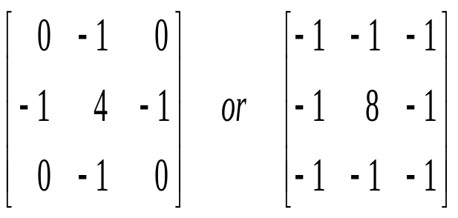
Second Order Derivative Operator
Second Derivative Operator:
  Better edge localization
  Laplacian Operator
  The resulting image exhibits a sign change at image edges => Zero crossing
Disadvantage of Laplacian
  Typically unacceptably sensitive to noise.
  Produce double edges
  Unable to detect edge direction

Slide 46
Zero Crossing Detection
  Zero Crossing offers an alternative in case when edges are blurry or a high noise content is present.
  At ZC, generate the output pixels for the edge map.
  Zero Crossing Detection
    for(i=0; i<(cols * (rows-1)); i++)
    if((image[i] < 0) && ((image[i+1] >= 0 || (image[i+cols] >=0)))
    out_buffer[i] = 255; /* Must check both Horizontal and vertical
    else if((image[i] > 0) && ((image[i+1] <= 0 || (image[i+cols] <=0)))
    out_buffer[i] = 255;
    else
    out_buffer[i] = 0;

Slide 47
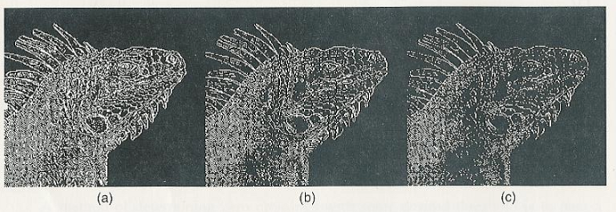
Zero Crossing Detection
Simple zero-crossing
  may indicate more edges than desired.
  A method of determining ZC with threshold:
    Must use threshold to determine the magnitude of the edge to mask .
    Pass a 3x3 window; determine the difference between the maximum and minimum; An edge is present if the difference exceeds the threshold.
Fig. 3.20 Different thresholds (a) 20, (b) 48, and (c) 72.

Slide 48
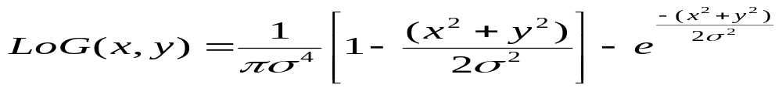
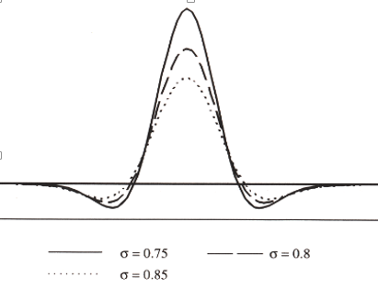


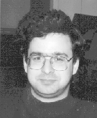
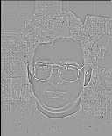
LoG(Laplacian of Gaussian)
LoG(Laplacian of Gaussian)
    A second order derivative edge detector less susceptible to noise
    Gaussian smoothing before applying Laplacian
Imput Image
7X7, σ=1.0
Input Image
7X7, σ=1.0

Slide 49






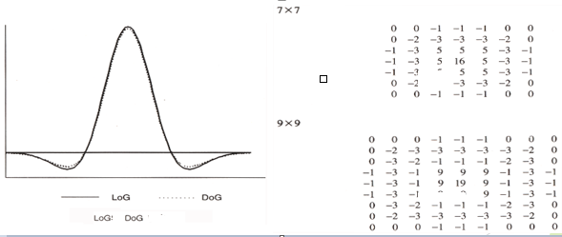

DoG(Difference of Gaussians)
DoG(Difference of Gaussians)
    Approximation of LoG (Cf. Heavy computation requirements of the LoG)
    The ratio results in a good approximation of LoG
      LoG ( ) vs. DoG ( )
    Can specify the width of edges to detect by varying and .
    The 9x9 mask will detect wider edges than 7x7 mask.

Slide 50

DoG(Difference of Gaussians)
Fig. 3.23 (a) Original, (b) 7x7 Dog, (c)zero-crossing, (d) 9x9 Dog, and (e) zero-crossing.

Slide 51

Color Edge Detection
Color Edge Detection
  Depends on your definition of an edge.
    (Def.1) the discontinuity in an image’s luminance => Edge detection would be done on the intensity channel of color image in HSU space.
    (Def. 2) the discontinuity in RGB channels => Edge detection is performed on each color components.
    (Def. 3) Performed each component; the components are summed to create the gray scale map.
  The best color edge detection => Depends on the application.

Slide 52



Color Edge Detection
(a) Blue Channel
(b) Green Channel
(c) Red Channel

Slide 53
Median Filtering
  Median filtering
    An effective method for removing impulse noise
    Preserve sharp edges(high frequency information) and detail
    Lowpass filter
      Suited for removing Gaussian noise, but not impulse noise
    Median filter is superior to lowpass filter when dealing with edges

Slide 54

Median Filtering
Fig. 3.25 (a) Noisy image, (b) low-pass filtered, and (c) median filtered.

Slide 55


Median Filtering
Median Filtering Method

Slide 56

Median Filtering

Slide 57

Median Filter
(a) Original image
(b) Median filtered with a 3 X 3 mask
(c) Median filtered with a 5 X 5 mask
(d) Median filtered with a 7 X 7 mask

Slide 58

Color Median Filtering
Color Median Filtering with separate R,G,B
  Apply median filter to each R, G, B, separately.
    (Problem) Lose any correlation between color components.
    Ex. Horizontal median filter of width 5 => Can not remove unwanted yellow pixel.

Slide 59


Color Median Filtering
Color median filtering using the unique property.
  A unique property of median values when filtering color image
    where N is the number of elements e.g., 9 for a 3 x 3 median filter; y is an arbitrary value in the window.
  (Idea) Break x, y in the unique property into read, green, blue components as follow:
    The pixel x_{i} with smallest Distance_{i} is the filter output, where x_{i} ={red_{i}, green_{i}, blue_{i}}
  (Algorithm): Computation of the color median output
      Start with N elements in the filter window
      Compute Distance_{i}, and find minimum Distance_{i}
      Return x_{i} with minimum Distance_{i}

Slide 60
Minimum/Maximum Filtering
Minimum/maximum filtering
    Very similar to median filtering.
    Max/min window value is used. Cf. Central pixel in median window value.
    Effective at removing extreme impulse noise.
      Min filter: removes white spikes; overall intensity will be reduced
      Max: removes dark spikes; overall intensity is increased
    Both the min and max filters fail in removing mixed impulse noises.
  Cascade of max min filters: can remove “salt and pepper noise”
    Closing filter: min -> max
    Opening filter: max -> min

Slide 61

Reference

Slide 62

Question

Slide 63

Thank you

